Slide 1


Research Agenda & Teaching Demo
Jiantong Wang
wang5jt@mail.uc.edu
Ph.D. Candidate in Business Analytics
Department of Operations, Business Analytics, & Information Systems
Lindner College of Business
University of Cincinnati
Notes:
Discrete data regression

Slide 2
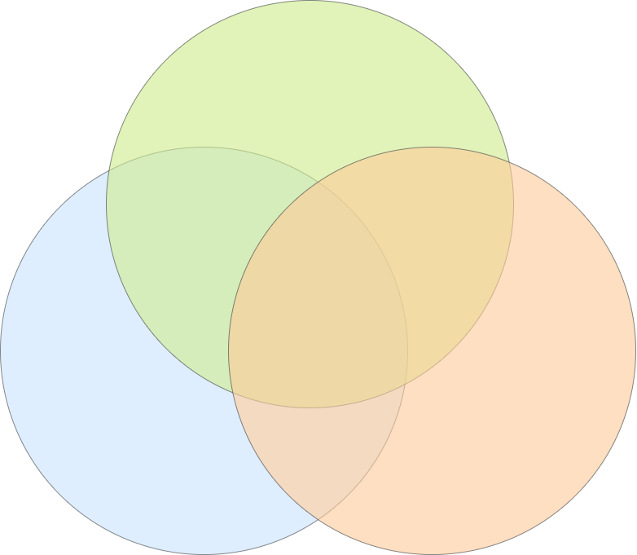

Research Overview
Machine Learning in Corporate Bankruptcy
QRIF: Identify genetic risk factors for extreme quantile of BMI
GMVCM:
Psychiatric Comorbidity
Identify GxE for Extreme Quantile in UK Biobank Data
Application
Complex Data:
Healthcare Records
Financial Data
Networks
Machine Learning
Statistics
Methodology & Theory
Computation
Shrinkage Bootstrap for Network Data
PriorEN: Prior Information Integrated Elastic Net Model
Varying Coefficient Model
for Image Data
2/39
2

Slide 3
Research Pipelines
High Dimensional Methods
Generalized Multivariate Varying Coefficient Model
for Psychiatric Comorbidity
Quantile Regression with Insights Fusion:
Application on Identifying Genetic Risk Factors for Obesity
Arxiv: arxiv.org/abs/2406.12212
Identify GxE for Extreme Quantile
in UK Biobank Data
Finance
Computation
Network
PriorEN:
Prior Information Integrated
Elastic Net Model
Shrinkage Bootstrap Method for Network Data
Machine Learning
for Corporate Bankruptcy Prediction
Varying Coefficient Model
for Image Data
3/39
3

Slide 4
Introduction to
Classification Tree
Jiantong Wang
Ph.D. Candidate, University of Cincinnati
wang5jt@mail.uc.edu
January 15th, 2025
Lab note has been uploaded to Canvas. You can also download it at https://jiantongwang.com/R_lab_handout.html.
4/39

Slide 5
Main topics
What is classification tree?
R demo with MBA admission data.
How actually does a classification tree work?
5/39
5
Notes:
what’s going on behind the R code?

Slide 6
Intro Example: Stay in / go out today?
Want to work today?
Yes
No
We decide stay in/go out through a series of simple decisions.
Stay in
Is the weather good?
Yes
No
Go out
Are there any good movies?
Yes
No
Go out
Stay in
6/39
6

Slide 7
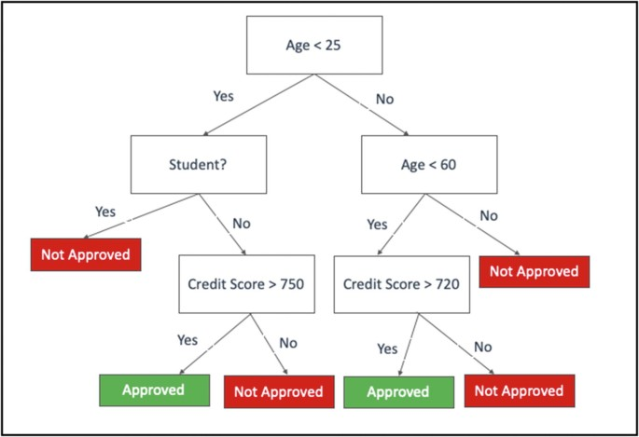
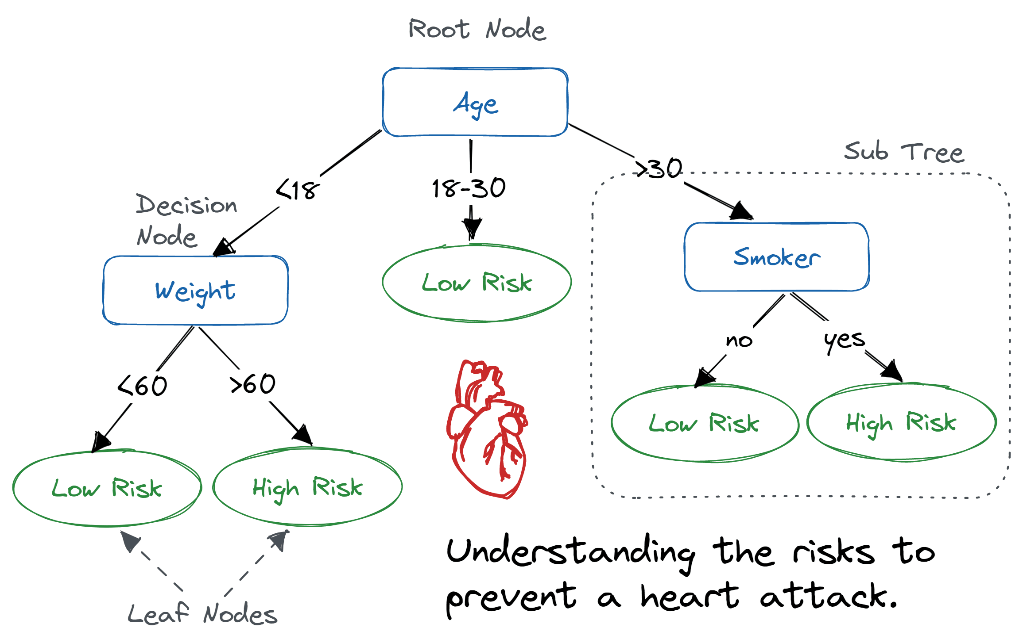
What Is a Classification Trees?
Definition:
  A classification tree is a model that predicts category of a target variable by applying a series of simple, data-driven decision rules.
Application Example:
  Determine Loan Approval
  Determine High/Low Disease Risks
7/39
7
Notes:
Source: https://link.springer.com/chapter/10.1007/978-1-4842-6500-0_5
https://www.datacamp.com/tutorial/decision-tree-classification-python

Slide 8
What Is a Classification Trees?
Definition:
  A classification tree is a model that predicts category of a target variable by applying a series of simple, data-driven decision rules.
Features:
  Interpretability
  Ease to implement
  Flexibility for a variety of data
Importance:
  Classification tree is one of the most important and fundamental models in machine learning and widely used in data mining.
8/39
8

Slide 9
Structure of Classification Tree
Root Node: The topmost decision node that includes the entire dataset.
Want to work today?
Yes
No
Decision Node: makes a decision to split the data.
Stay in
Is it sunny today?
Yes
Branch: connects nodes, show decision path to a leaf node.
No
Go out
Are there any good movies?
Leaf Node/Terminal Node: A node where no further splitting occurs.
It contains the class label to be assigned to new data points.
Yes
No
Go out
Stay in
Depth: The length of the longest path from a node to a leaf.
9/39
9

Slide 10
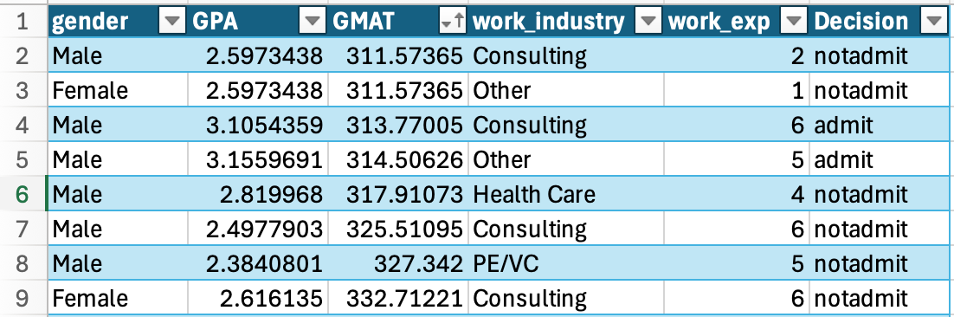
Toy Example: MBA Admission
Data:
  Historical records of applicants to an MBA program from previous years.
Goal:
  To predict admit decisions for future applicants (Admit / Not admit).
Variables:
  To make things simple, we will first focus on two predictors: GPA and GMAT.
10/39
10

Slide 11
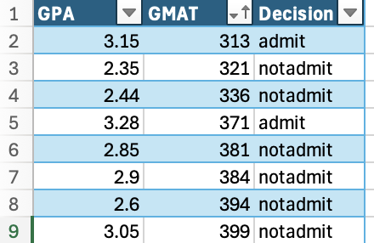
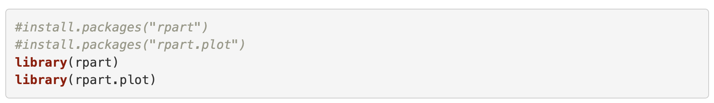
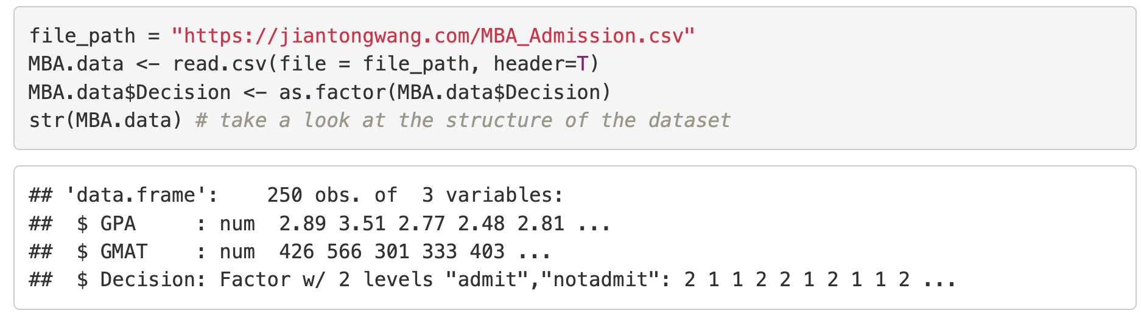
Demo: Building a Classification Tree
Packages: “rpart” and “rpart.plot”
Dataset: MBA Application data
11/39
11

Slide 12
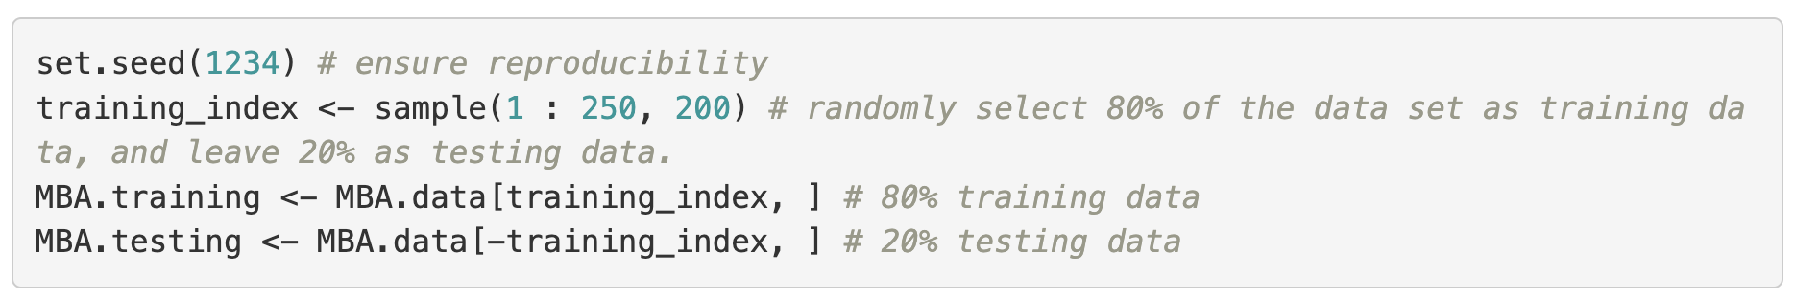
Demo: Building a Classification Tree
80% training data, 20% testing data
For reproducibility, we set random seed “1234”
12/39
12

Slide 13
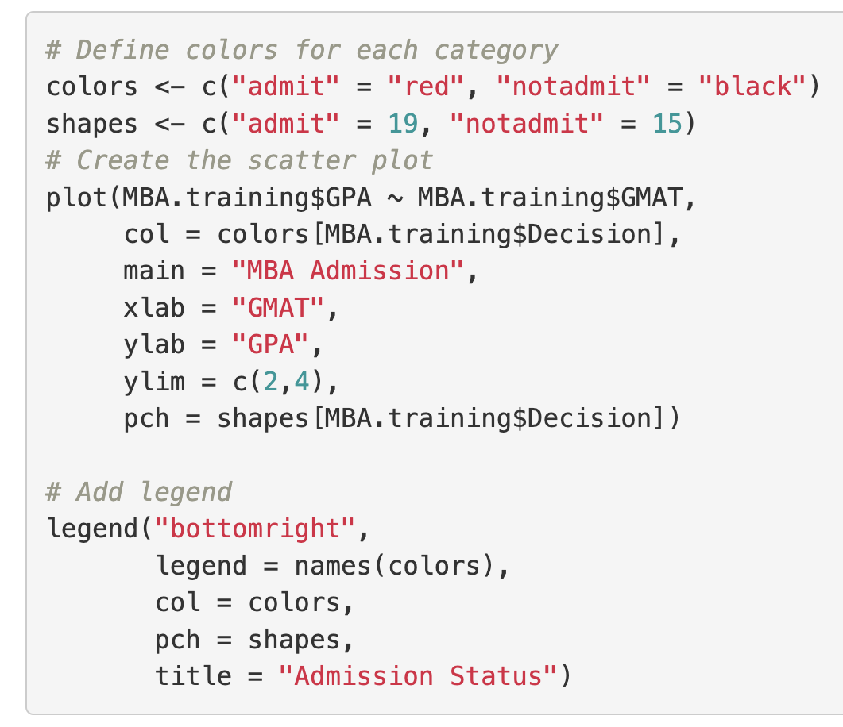
Demo: Building a Classification Tree
13/39
13

Slide 14
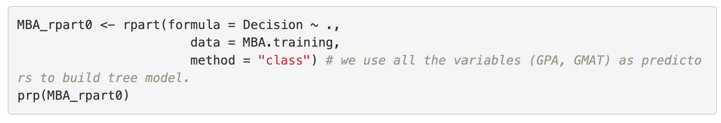
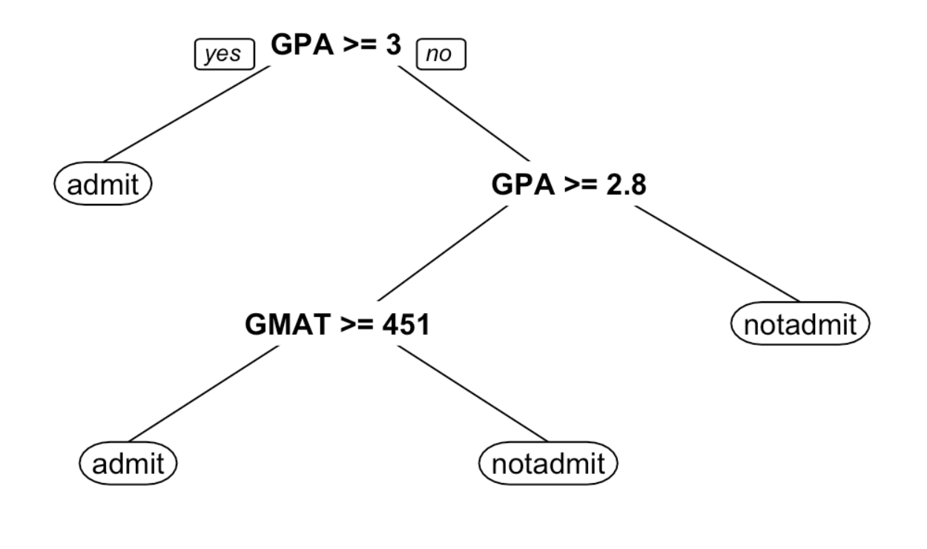
Fit Classification Tree Model
How does the model build behind the R code?
14/39
14

Slide 15
The underlying idea of classification trees
Recursively separate the records into subgroups by creating splits on the predictors (make decisions).
This splitting of the data set can be visualized as trees.
Admit
GPA >= 3.0?
Yes
No
Admit
GPA >= 2.8?
Not admit
Admit
Yes
No
Not admit
GMAT >= 451?
Not admit
Yes
No
Admit
Not admit
15/39

Slide 16
The Key Questions
GPA >= 3.0?
How to choose the split variable and its value?
Yes
No
Admit
GPA >= 2.8?
When should we stop?
Yes
No
How to determine class in the terminal nodes?
GMAT >= 451?
Not Admit
Yes
No
How do we predict for new data ?
Admit
Not Admit
16/39

Slide 17
Which variable to split?
Variable 1: GMAT?
Variable 2: GPA?
17/39

Slide 18
Which value to choose?
Split value 1: GPA > 3.2?
Split value 2: GPA > 3.0?
18/39

Slide 19
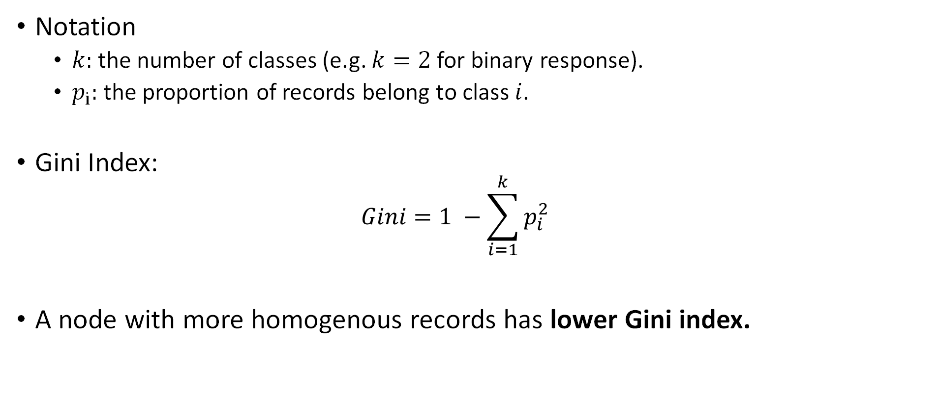
Determining the Best Split: Impurity Measures
Notation
  $k:$ the number of classes (e.g. $k=2$for binary response).
  $p_{i}:$ the proportion of records belong to class $i$.
Gini Index:
  $$Gini=1 −\sum_{i=1}^{k}{p_{i}^{2}}$$
A node with more homogenous records has lower Gini index.
19/39

Slide 20
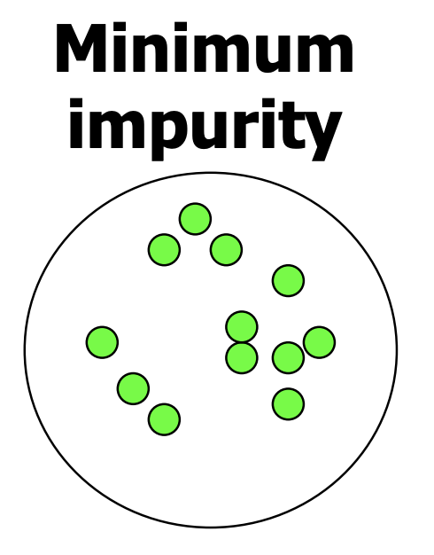
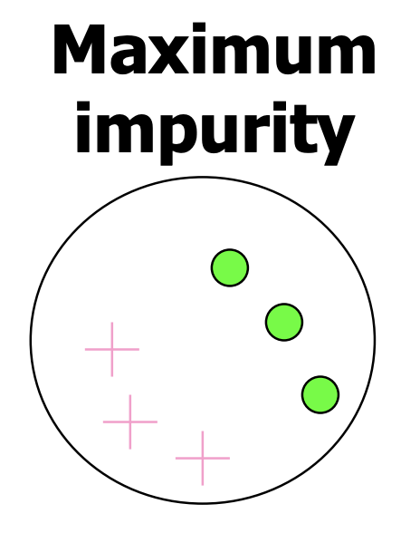
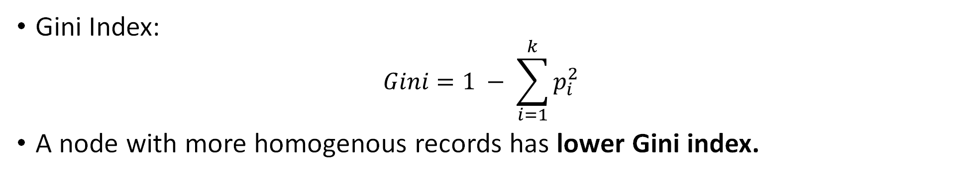

Determining the Best Split: Impurity Measures
Gini Index:
$$Gini=1 − \sum_{i=1}^{k}{p_{i}^{2}}$$
A node with more homogenous records has lower Gini index.
$$Gini=1 − 1^{2}=0$$
$$Gini=1 −({{0.5}^{2}+0.5}^{2})=0.5$$
20/39

Slide 21
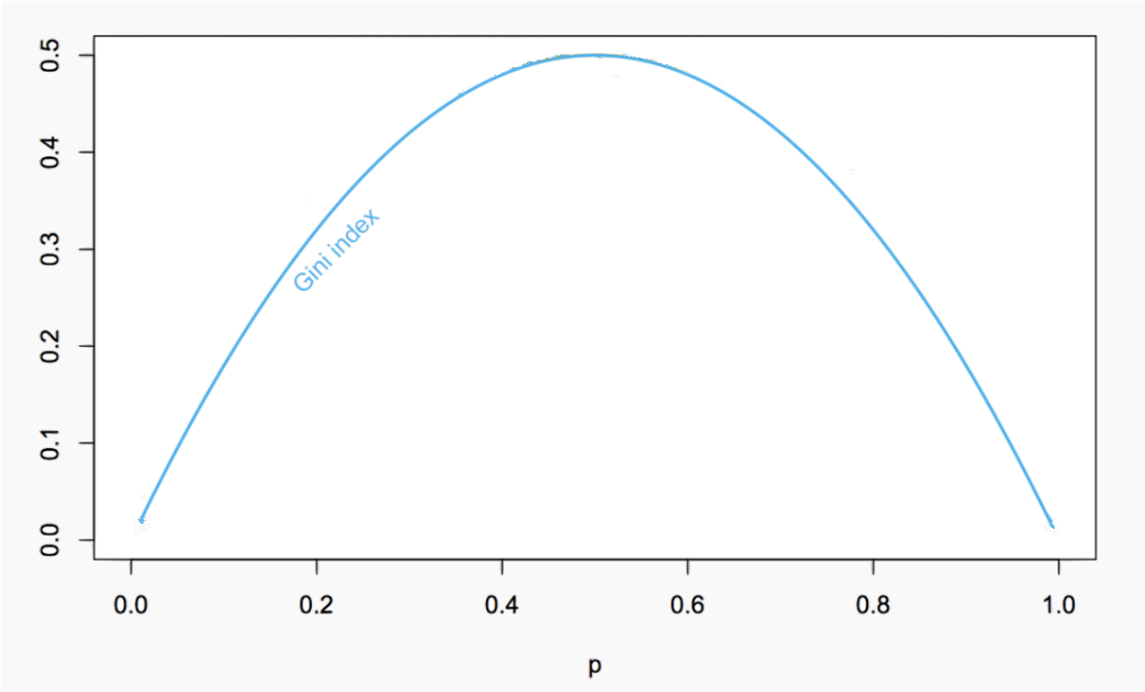
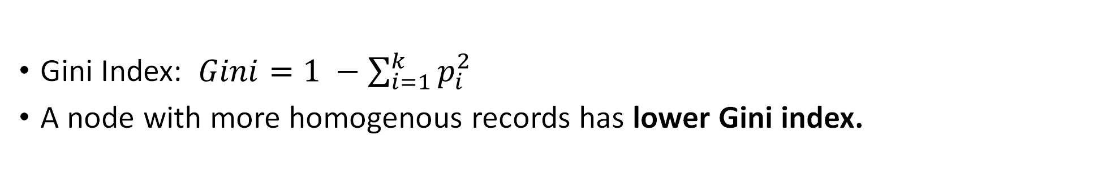
Determining the Best Split: Impurity Measures
Gini Index: $Gini=1 −\sum_{i=1}^{k}{p_{i}^{2}}$
A node with more homogenous records has lower Gini index.
21/39

Slide 22
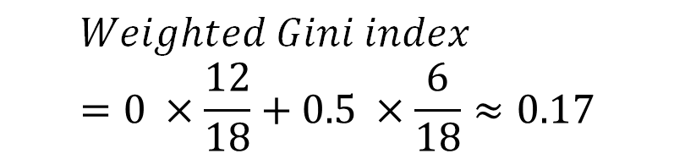
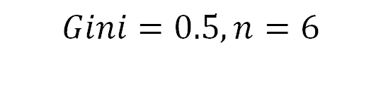
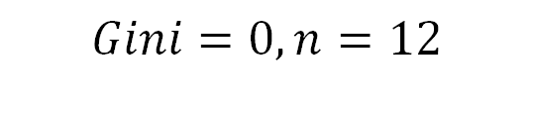
Determining the Best Split: Impurity Measures
Weighted average impurity measures of subnodes.
A split with lower weighted Gini index is preferred.
$$Weighted Gini index=0 ×\frac{12}{18}+0.5 ×\frac{6}{18}≈0.17$$
A split
$$Gini=0, n=12$$
$$Gini=0.5, n=6$$
22/39

Slide 23
Determining the Best Split: Impurity Measures
For each variable, each possible split value is tried
  Calculate the impurity of the resulting sub-nodes.
  Summarize the impurity of the split as the weighted average of the impurities of the sub-nodes.
  rpart() function uses weighted Gini Index as default.
Each variable is tried.
Select the best “variable-value” split (lowest weighted Gini index).
23/39

Slide 24
Which value to choose?
Split value 1: GPA > 3.2?
Gini = 0.268
Split value 2: GPA > 3.0?
Gini = 0.172
24/39

Slide 25
Which variable to split?
Variable 1: GMAT
Variable 2: GPA
25/39

Slide 26

How to split?
GPA >= 3.0?
How to choose the split variable and its value?
Use impurity measures like the Gini Index
Yes
No
Admit
GPA >= 2.8?
When should we stop?
Yes
No
How to determine class in the terminal nodes?
GMAT >= 451?
Not Admit
Yes
No
How do we predict for new data ?
Admit
Not Admit
26/39

Slide 27
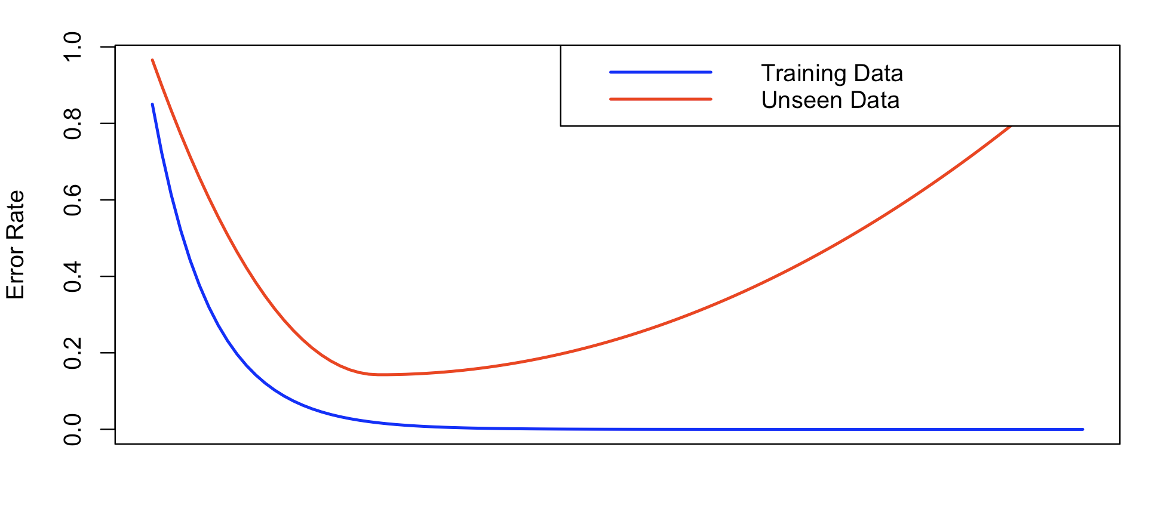
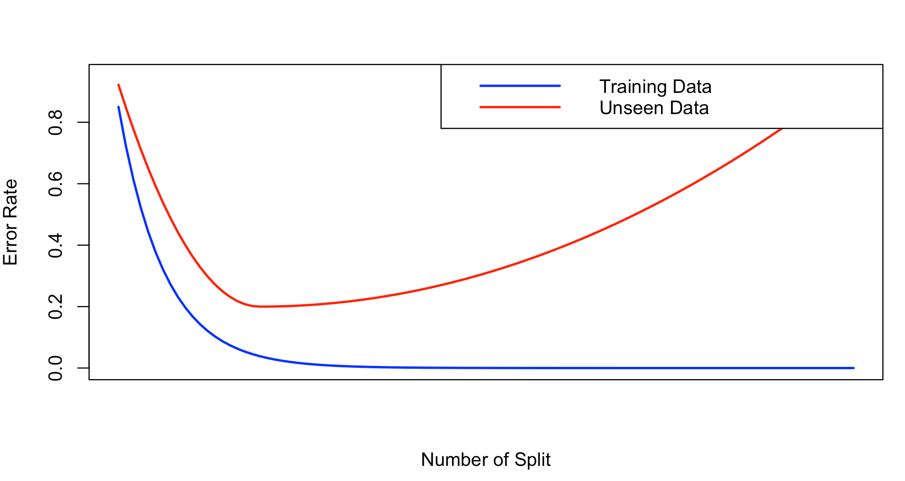
When should we stop?
Avoid overfitting:
  There is a chance of overfitting if we keep splitting the data until we only have very few points at each node
Stop here
Goal:
to arrive at a tree that captures the patterns but not the noise in the training data
to maximize the prediction accuracy on new data
Tree learns relationship between the response variable and the predictors
Tree learns noise from the training data.
27/39

Slide 28
When should we stop?
GPA >= 3.0?
How to choose the split variable and its value?
Use measures like the Gini Index
Yes
No
Admit
GPA >= 2.8?
When should we stop?
Avoid overfitting
(will be discussed next class)
Yes
No
How to determine class in the terminal nodes?
GMAT >= 451?
Not Admit
Yes
No
How do we predict for new data ?
Admit
Not Admit
28/39

Slide 29
Decision Rules in the End Nodes
GPA >= 3.0?
How to choose the split variable and its value?
Use measures like the Gini Index
Yes
No
98 Admit
4 Not admit
GPA >= 2.8?
When should we stop?
Avoid overfitting
(will be discussed next class)
Yes
No
How to determine class in the terminal nodes?
Majority vote or
using other cutoff probability
GMAT >= 451?
0 Admit
64 Not admit
Yes
No
How do we predict for new data ?
13 Admit
5 Not admit
3 Admit
13 Not admit
29/39

Slide 30


Prediction with Classification Tree
SpongeBob🧽 wants to get promoted to the manager at the Krusty Krab.
He considers taking an MBA program would be a great way to help.
SpongeBob’s GPA is 2.95, and his GMAT is 550. Will he be admitted?
30/39
Notes:
Source: By NickRewind - Screenshot from File:SpongeBob BingePants Podcast Trailer.webm, CC BY 3.0, https://commons.wikimedia.org/w/index.php?curid=138420249
https://medium.com/@samabidi/what-spongebob-can-teach-us-about-productivity-39ba1b20b54f

Slide 31
Will SpongeBob be admitted?
🧽
GPA 2.9
GMAT 550
GPA >= 3.0?
How to choose the split variable and its value?
Use measures like the Gini Index
Yes
No
Admit
When should we stop?
Avoid overfitting
(will be discussed next class)
GPA >= 2.8?
Yes
How to determine class in the terminal nodes?
Majority vote or
using other cutoff probability
No
GMAT >= 451?
Not Admit
Yes
No
How do we predict for new data ?
We “walk” through the tree!
Admit
Not Admit
31/39

Slide 32
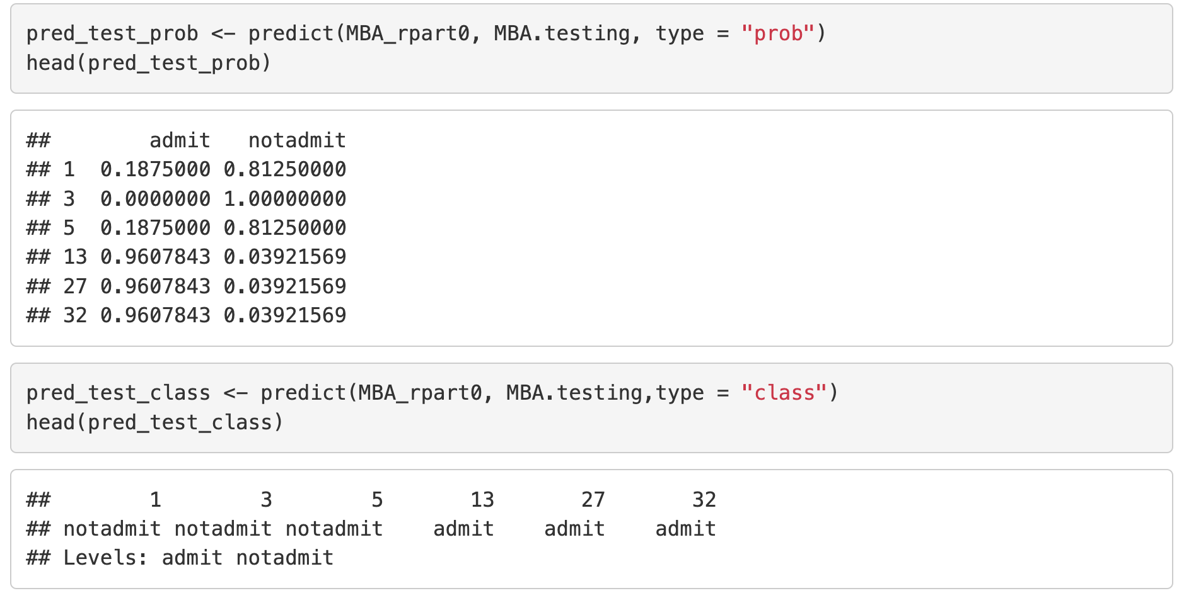
Make Prediction with Fitted Model
We can use predict() function to make prediction with our fitted tree model.
  type = “prob”: predicted probability of each class;
  type = “class”: predicted class with cut-off threshold of 0.5 (majority vote).
32/39

Slide 33
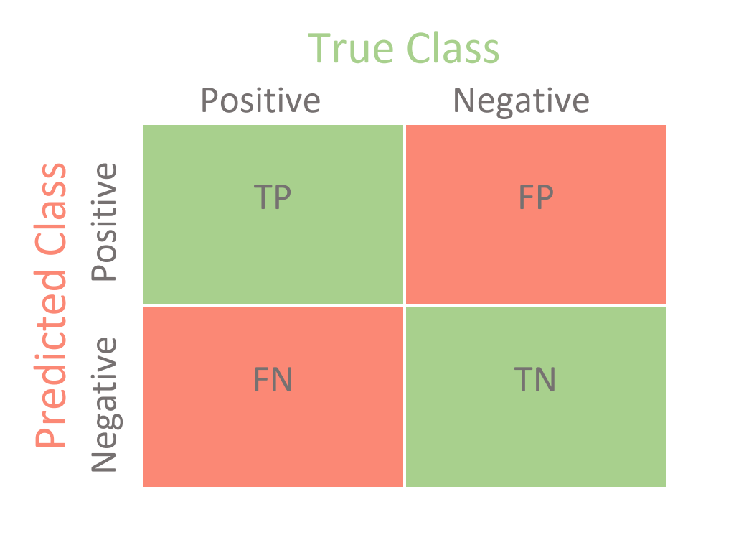
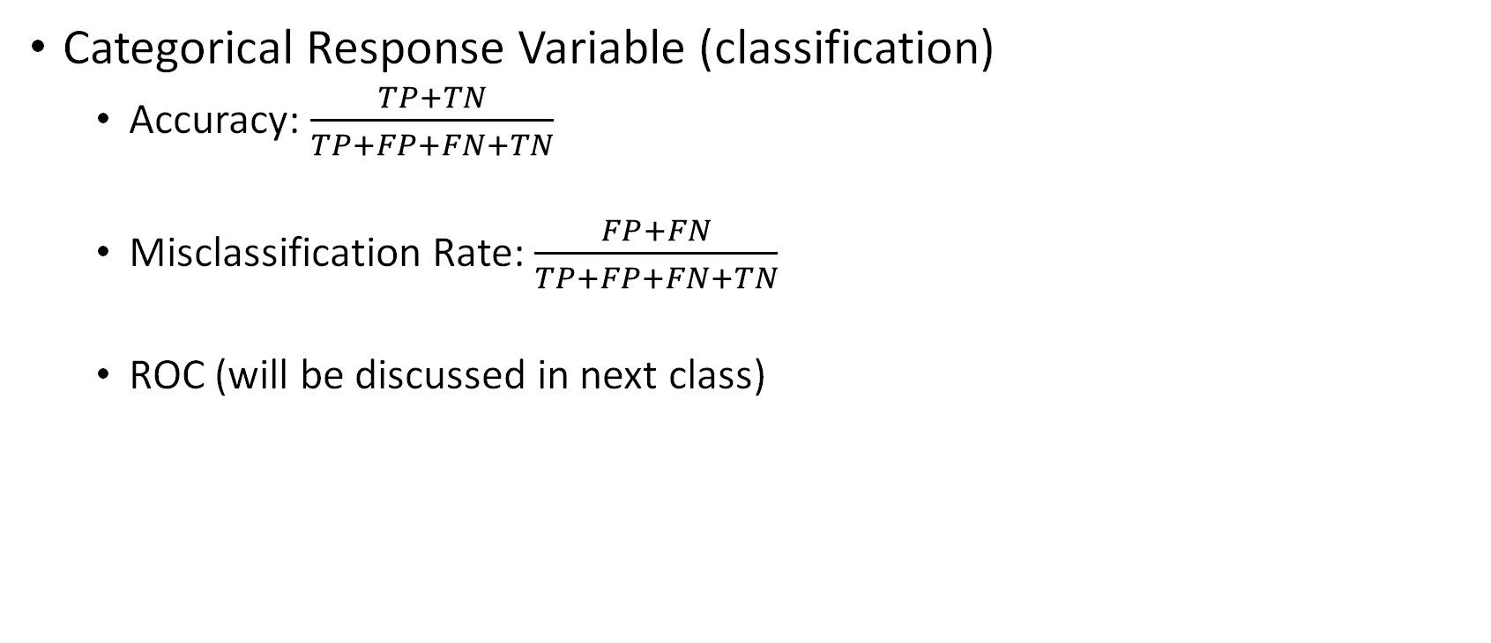
Model Performance Assessment
Categorical Response Variable (classification)
  Accuracy: $\frac{TP+TN}{TP+FP+FN+TN}$
  Misclassification Rate: $\frac{FP+FN}{TP+FP+FN+TN}$
  ROC (will be discussed in next class)
33/39

Slide 34
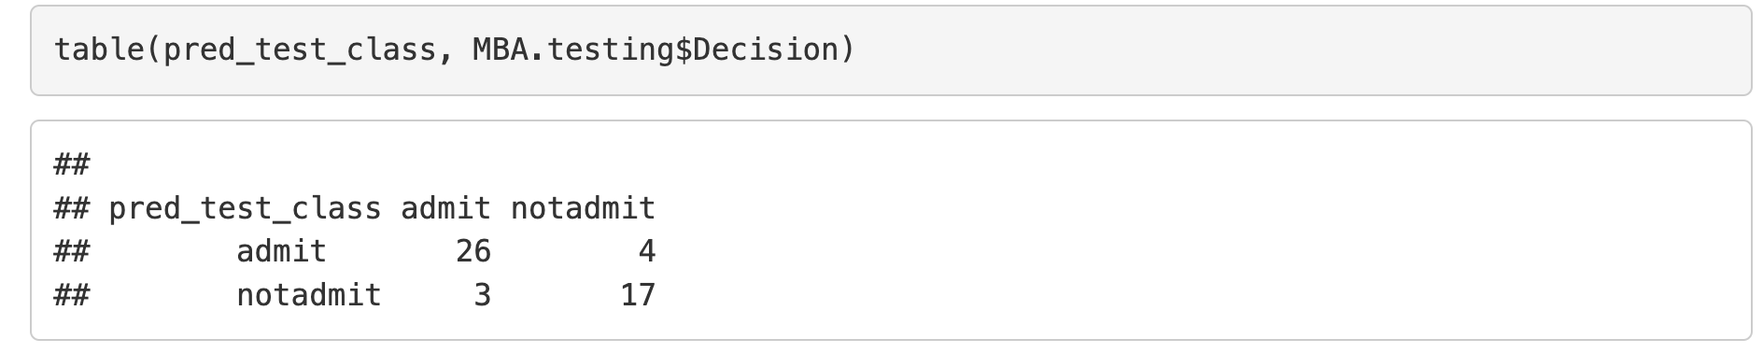
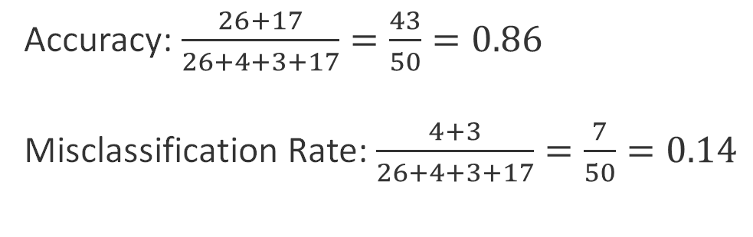
Assess Model Prediction Performance
Accuracy: $\frac{26+17}{26+4+3+17}=\frac{43}{50}=0.86$
Misclassification Rate: $\frac{4+3}{26+4+3+17}=\frac{7}{50}=0.14$
34/39

Slide 35
Summary
Classification Trees:
  Definition and structure
  Underlying idea: create splits based on predictors
Key Questions:
  How to find the best split? Use weighted Gini Index or Entropy
  When should we stop? Avoid overfitting.
  How to decide class for leaf node? Majority vote.
  How to make prediction for new data? Walk through the tree.
Implementation in R
  Built and visualized a classification tree in R
  Assessed model performance using predictions and accuracy.
35/39

Slide 36
See you next week!
As always, please feel free to send me an email if you have any questions.
wang5jt@mail.uc.edu
36/39

Slide 37
Teaching Interests
Business Analytics Methods, Data Mining, Optimization, Statistical Methods, Data Visualization, Time Series Analysis, Database Management
I’m confident but not limited to:
37/39

Slide 38
Potential New Courses for Xavier
Forecasting and Risk Analysis (Time series data basics, Data visualization, ARIMA model, etc.)
Machine Learning for Business (SVM, Random Forest, Neural Network, etc.)
Statistical Computing (Simulation, Bootstrap, Parallel computation, Monte Carlo method, etc.)
Statistics for Human Genetics (Genetic data basics, Disease risk prediction, etc.)
Unstructured Data Mining (Text, Images, Video, and Voice)
Data Analysis with AI (AI for data processing, AI-assisted programming, AI-powered Spreadsheet Analysis, etc.)
38/39

Slide 39
Thank you!
39/39

